Slide 1
WELCOME TO PROJECT 04 PRESENTATION

Slide 2


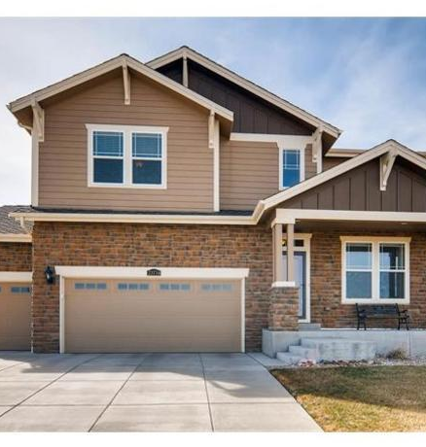


RENTAL HOUSE PRICE PREDICTION MODEL
z
JOSH MARTIN
ARCHANA KARRI
UDESHI PEREIRA
SUBMITTED BY :- GROUP 02

Slide 3

HYPOTHESIS
z
Size of a rental property is the most significant factor in determining the rental price.

Slide 4
OUTLINE
Abstract
Introduction
Goal
Purpose
Project Summary
ETL & Modelling
Models Used
Analysis & prediction

Slide 5

ABSTRACT
Real estate is least transparent industry in our ecosystem.
Rental prices change every year, so there is a need for a system to predict house prices in the future.
Predicting Rental Prices with real factors.
We aim to make evaluations based on every basic parameter that is considered while determining the price

Slide 6

INTRODUCTION
This project aims to identify the best machine learning algorithms to predict RENTAL prices, in major cities of India.

Slide 7

To Implement a machine learning model capable of predicting the house rental price based on various parameters.
GOAL

Slide 8
PURPOSE Finding the ideal housing option according to budget and preferences is such a hassle. The cost of house rent depends on many factors such as the house size, number of bedrooms, locality and a lot more. In real world, with the use of available data we can create an appropriate machine learning algorithms where real estate agents(property managers) can find the ideal house according to customers’ budgets and preferences with ease.
z

Slide 9
z
PROJECT SUMMARY
Our Project is to build a machine learning model, based on certain specifications you have provided about your future rental home, then it will predict the most accurate price.

Slide 10

z
The basic procedures implemented to achieve the goals of this research are:
1. Data collection
2. Initial analysis
3. ETL (Extract Transform Load)
4. Modelling
5. Model evaluation

Slide 11
Data collection
The dataset used in this project was obtained from Kaggle. It has information on about 4700+ houses available for rent with different parameters ranging from; size to the number of bedrooms, halls, and kitchens to the locality, and furnishing status, among others.

Slide 12
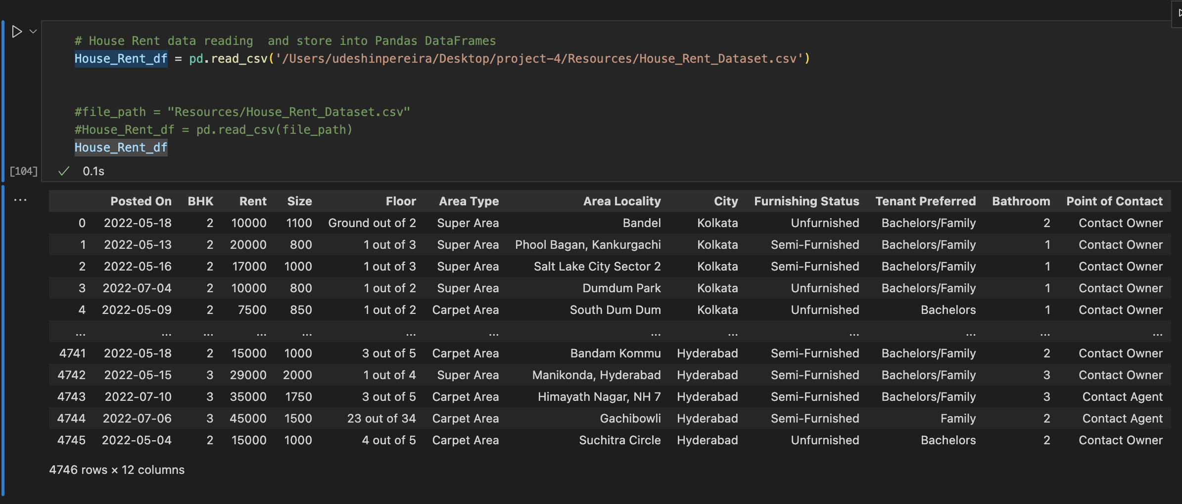
Raw Data

Slide 13
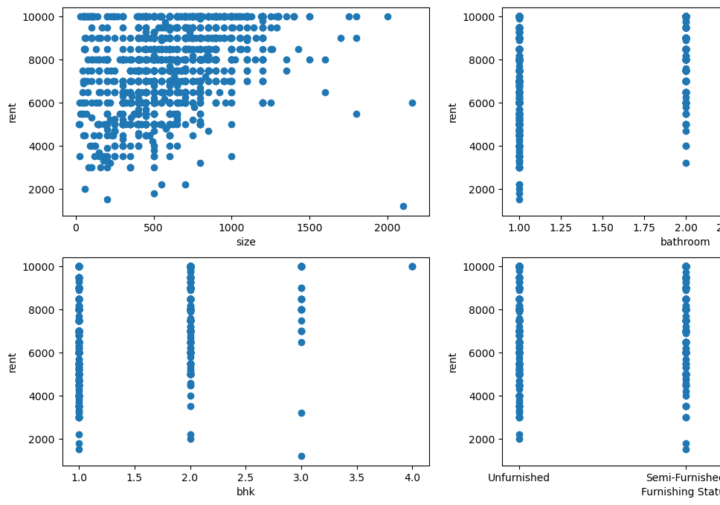
Initial analysis
z
We explored the data to check if there are trends between the explanatory variables and the target variable.

Slide 14
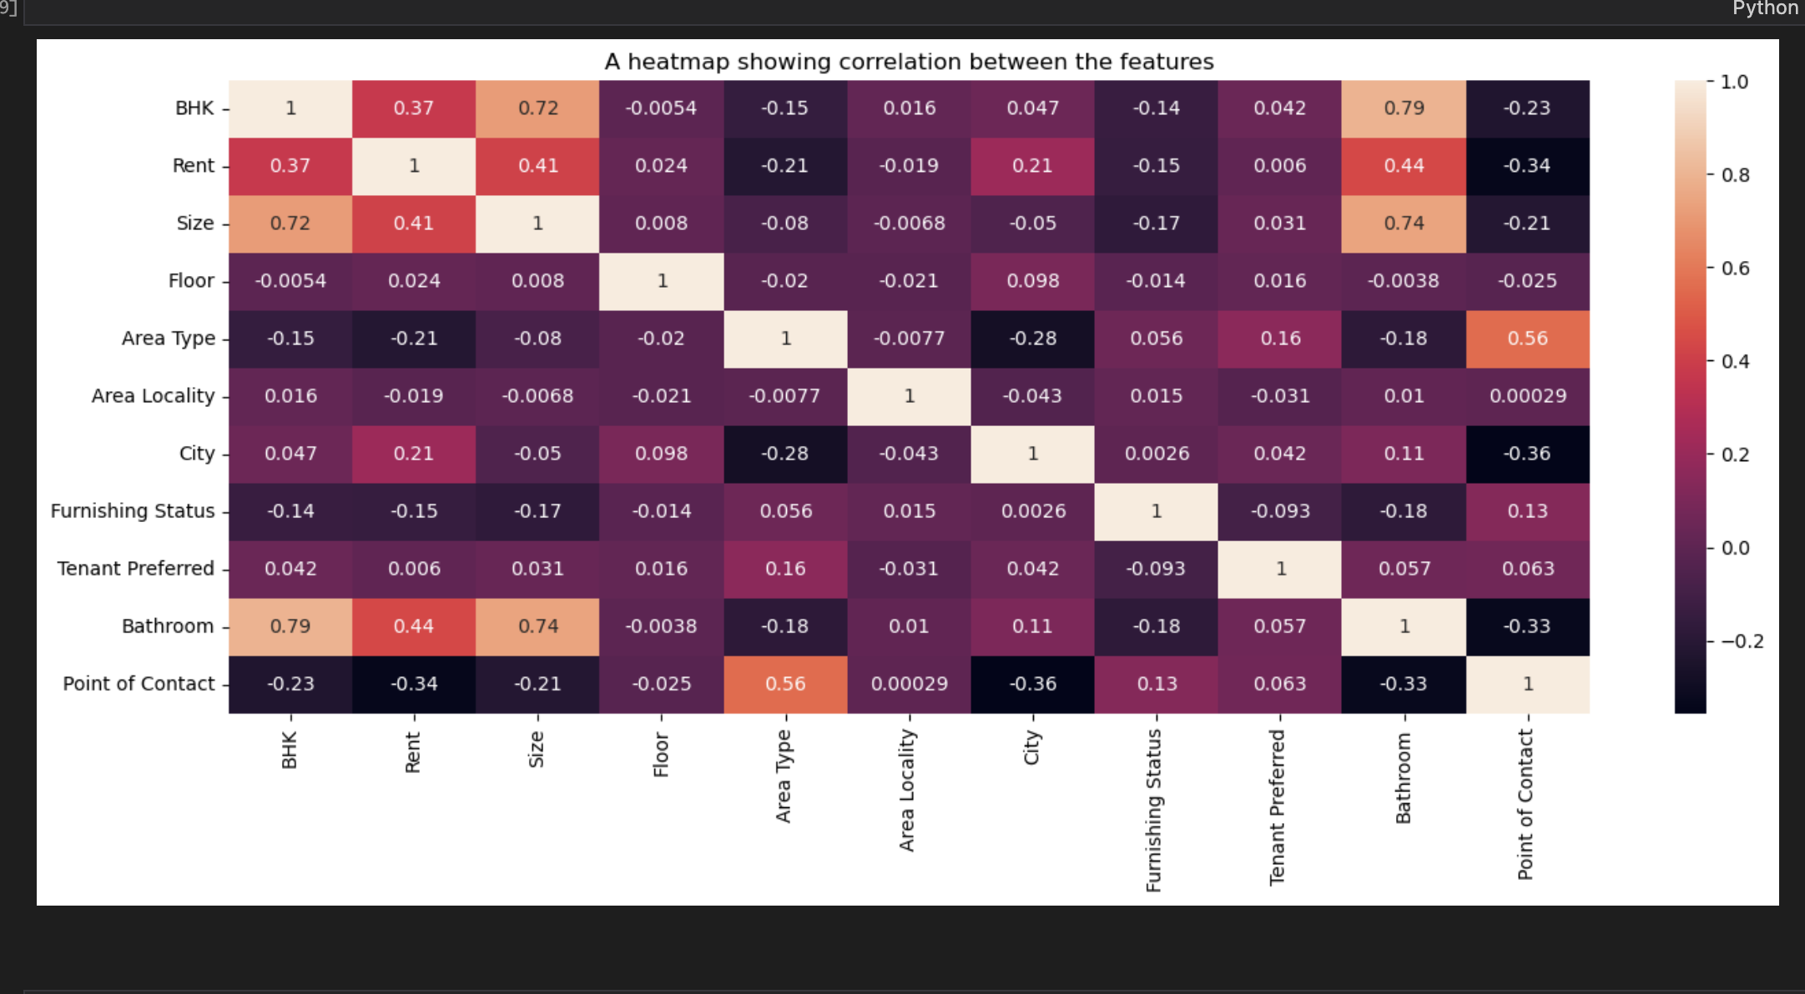
z
We decided to visualize the correlation of the features as shown on the heat map.
Observation:
The size, bathroom and bedrooms have high correlation to the house rent among other attributes. There is no such high correlation with price attribute

Slide 15




1.Extract
ETL Process
2.Transform
z
3.Load

Slide 16
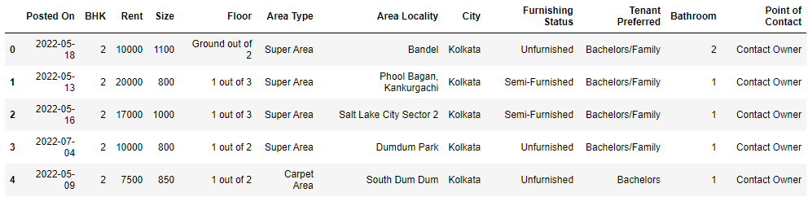
Extract
Retrieve and verify data from csv file
z

Slide 17
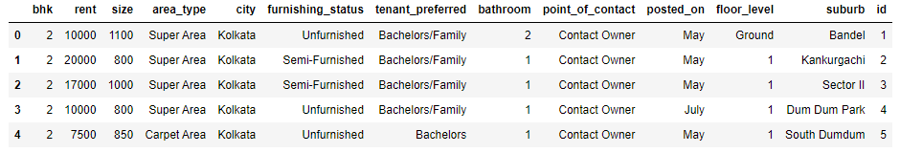
Transform
Converting data types
Creating new columns
Dropping unnecessary columns
Renaming columns
Querying Google Maps for geolocation information
z

Slide 18
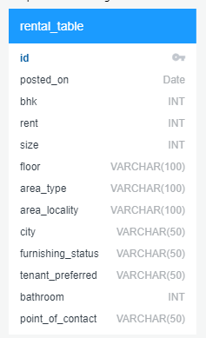
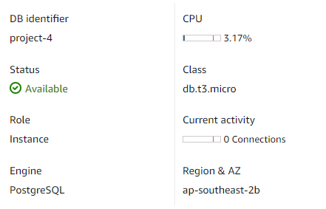
Load
Create Database
Create table schema
Connect to RDS using PGAdmin
Create table
Load data to RDS
z

Slide 19

Creating the Model
Data Preparation
Data Pre-processing
Model Evaluation
Model Selection
Hyperparameter Tuning
Model Saving
z

Slide 20
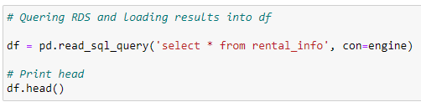
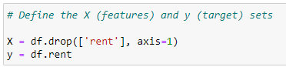
Preparation
Data Preparation
Data Pre-processing
Model Evaluation
Model Selection
Hyperparameter Tuning
Model Saving
z

Slide 21
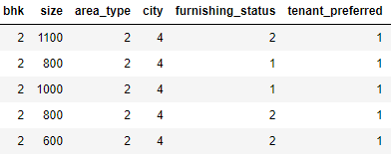
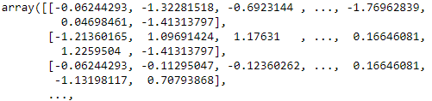
Pre-processing
Data Preparation
Data Pre-processing
Model Evaluation
Model Selection
Hyperparameter Tuning
Model Saving
z

Slide 22
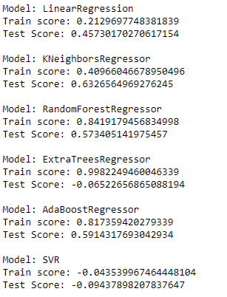
Model Evaluation
Data Preparation
Data Pre-processing
Model Evaluation
Model Selection
Hyperparameter Tuning
Model Saving
z

Slide 23
Model Selection
Data Preparation
Data Pre-processing
Model Evaluation
Model Selection
Hyperparameter Tuning
Model Saving
z

Slide 24
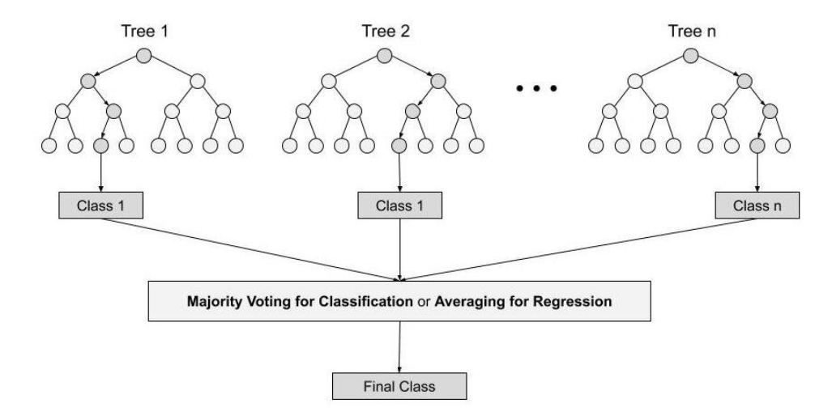
Random forest Regression
Data Preparation
Data Pre-processing
Model Evaluation
Model Selection
Hyperparameter Tuning
Model Saving
z
Random forests are created from subsets of data and the final output is based on average or majority ranking and hence the problem of overfitting is taken care of.

Slide 25
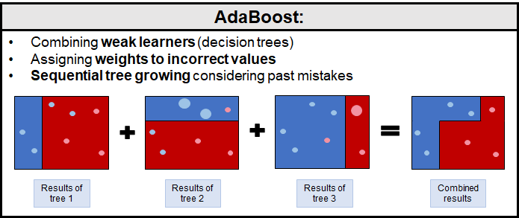
Ada Boost Regression
Data Preparation
Data Pre-processing
Model Evaluation
Model Selection
Hyperparameter Tuning
Model Saving
z

Slide 26
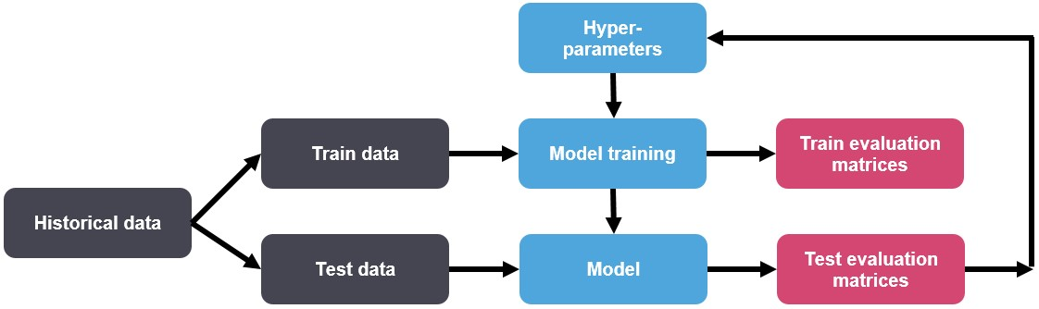
Hyperparameter Tuning
Data Preparation
Data Pre-processing
Model Evaluation
Model Selection
Hyperparameter Tuning
Model Saving
Hyperparameter tuning is about finding a set of optimal hyperparameter values which maximizes the model's performance, minimizes loss and produces better outputs.
Both Random Forest Regressor and the AdaBoost Regressor will go through the hyperparameter tuning .
z
Display the params with the best results

Slide 27
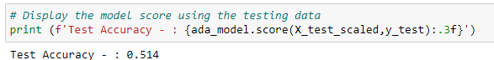
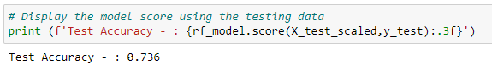
Why are we choosing Random Forest Regression model over Ada boost Regression here?
Random Forest Regression
RF solves the problem of overfitting as output is based on majority voting or averaging. RF performs well even if the data contains null/missing values.
Each decision tree created is independent of the other thus it shows the property of parallelization.
It is highly stable as the average answers given by a large number of trees are taken into consideration.
Adaboost Regression
Adaboost uses the serialization property and hence it is slow and dependent on previous values. Different stumps have different amount of say in the final decision. The stump which makes less error in the prediction, has high amount of say as compared to the stump which makes more errors. There are good chances of Adaboost to overfit.

Slide 28
Saving Model
Data Preparation
Data Pre-processing
Model Evaluation
Model Selection
Hyperparameter Tuning
Model Saving
Generated RF model using joblib dump and load functionalities is saved along with the scaler and the mapping information and is loaded to make predictions.
z
To run the file use the following command in the command-line or terminal.

Slide 29
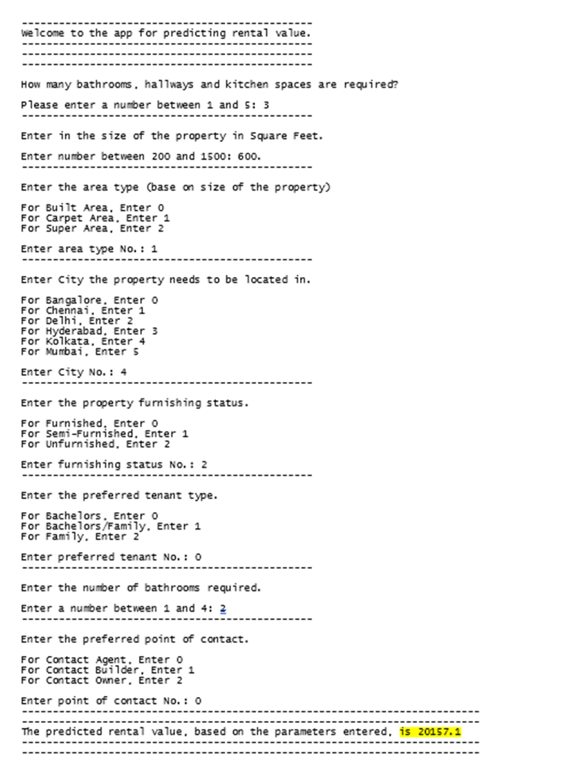
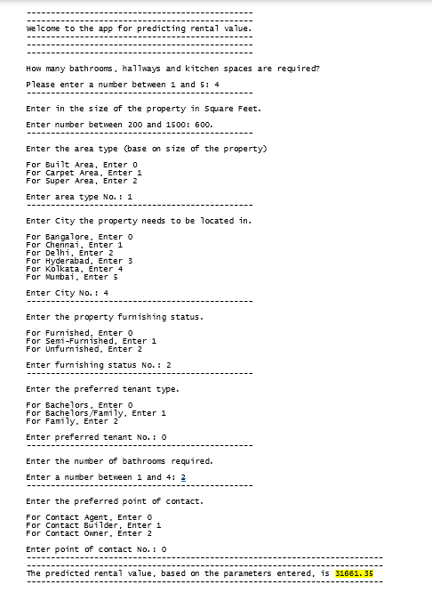
Results

Slide 30

Conclusion
Hence, House Rent Prediction is a complex process involving many dependent variables.
In contrast to our Hypothesis, rental value is not just dependent on the floor size. When any other parameters change, there may be a significant change in the prediction.

Slide 31


